Slide 1

Block Coding
Block coding is normally referred to as mB/nB coding
it replaces each m-bit group with an n-bit group.
Can give redundancy to ensure synchronization and improve performance of line coding.

Slide 2
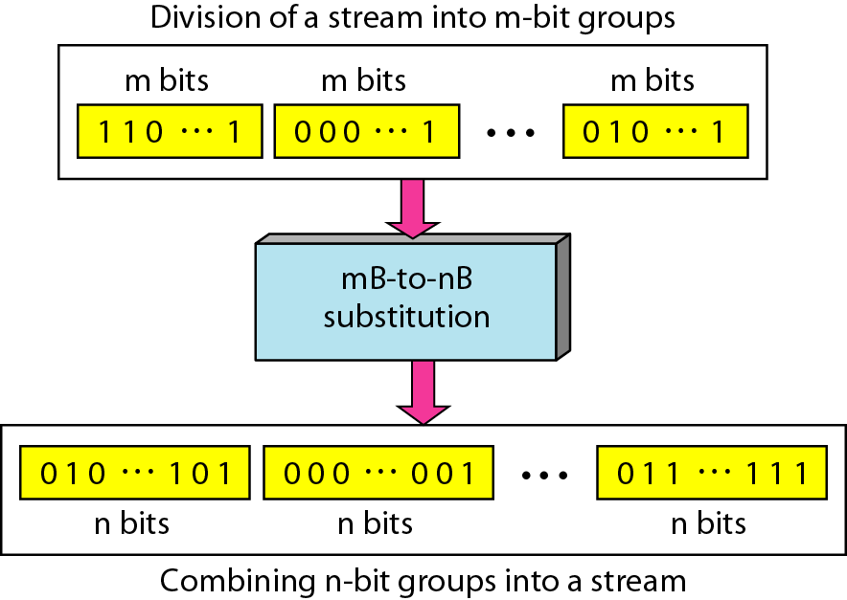
Figure 4.14 Block coding concept

Slide 3
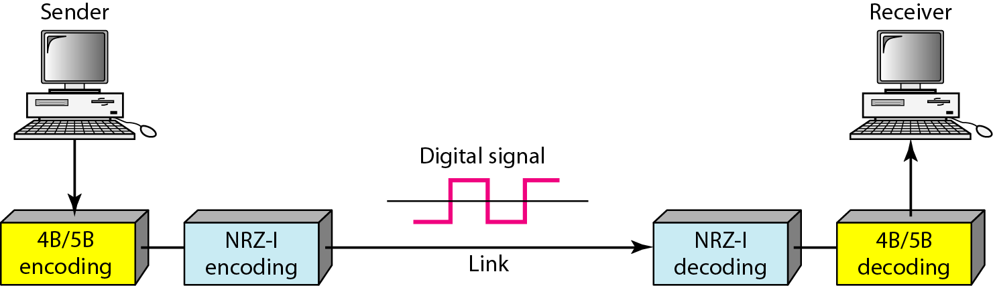
Figure 4.15 Using block coding 4B/5B with NRZ-I line coding scheme

Slide 4
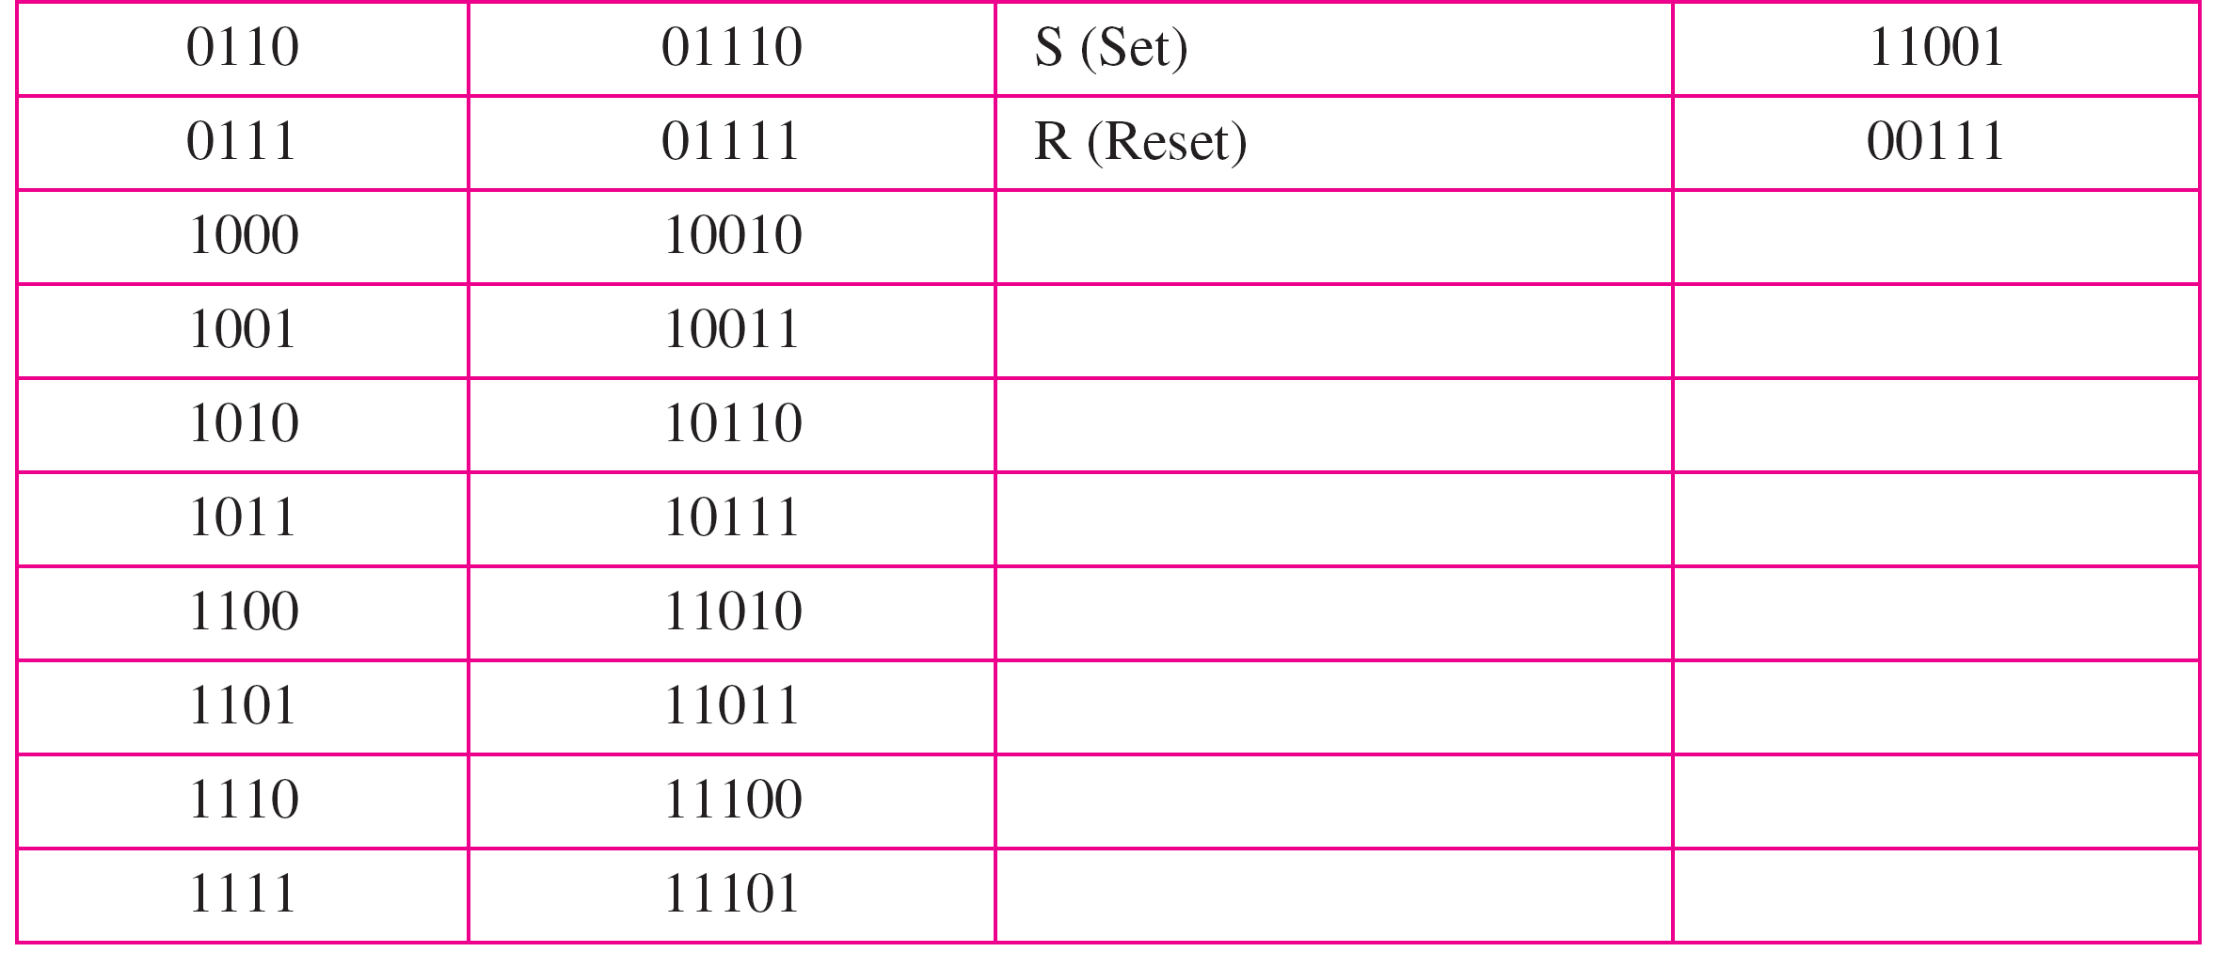
Table 4.2 4B/5B mapping codes

Slide 5
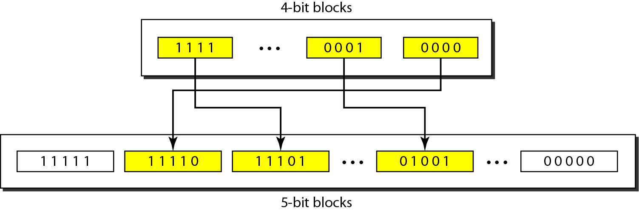
Figure 4.16 Substitution in 4B/5B block coding

Slide 6
Redundancy bits add 20 percent more baud
Does not solve the DC component of the NRZ-I baud.

Slide 7
Example 4.5(Homework)
We need to send data at a 1-Mbps rate. What is the minimum required bandwidth, using a combination of 4B/5B and NRZ-I or Manchester coding?
Solution
First 4B/5B block coding increases the bit rate to 1.25 Mbps. The minimum bandwidth using NRZ-I is N/2 or 625 kHz. The Manchester scheme needs a minimum bandwidth of 1 MHz. The first choice needs a lower bandwidth, but has a DC component problem; the second choice needs a higher bandwidth, but does not have a DC component problem.

Slide 8
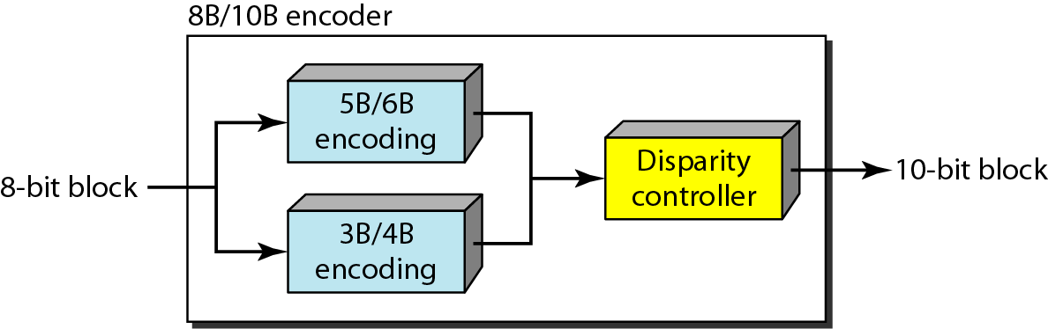
Figure 4.17 8B/10B block encoding

Slide 9
Scrambling

Slide 10
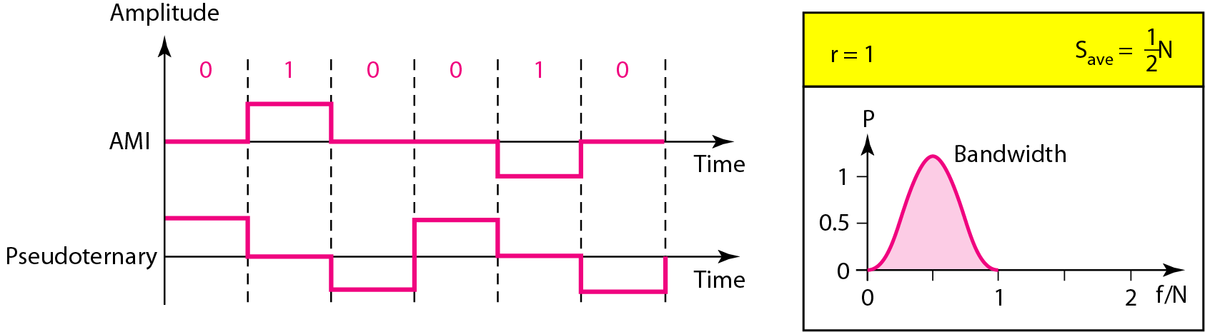
Figure 4.9 revisiting Bipolar schemes: AMI and pseudoternary

Slide 11
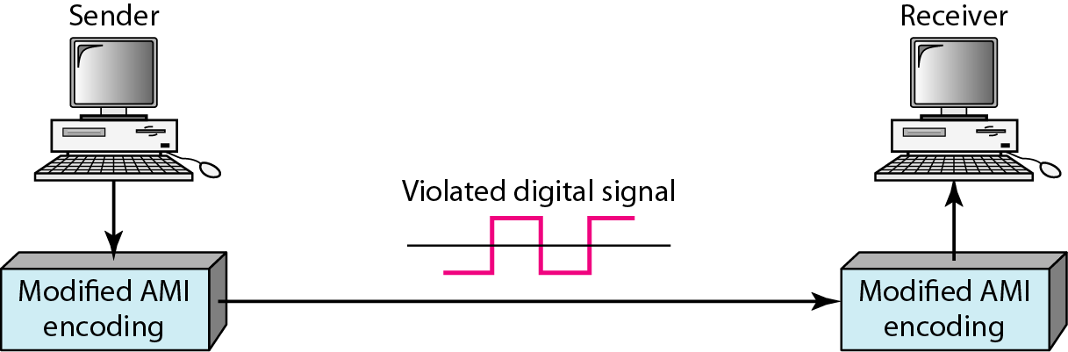
Figure 4.18 AMI used with scrambling

Slide 12
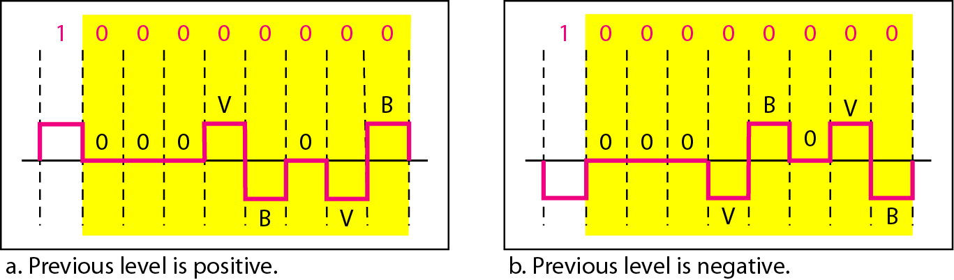
Figure 4.19 Two cases of B8ZS scrambling technique

Slide 13
Note
B8ZS substitutes eight consecutive zeros with 000VB0VB.

Slide 14
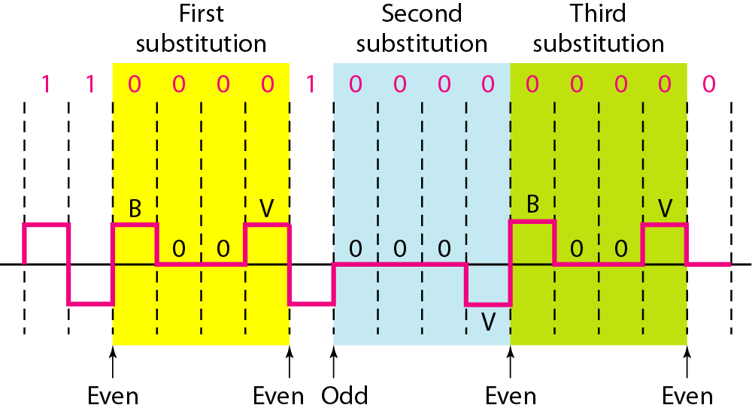
Figure 4.20 Different situations in HDB3 scrambling technique

Slide 15
Figure 4.20 Different situations in HDB3 scrambling technique

Slide 16
Note
HDB3 substitutes four consecutive zeros with 000V or B00V depending
on the number of nonzero pulses after the last substitution.

